Slide 1
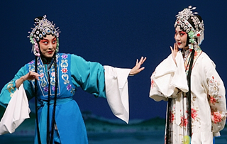
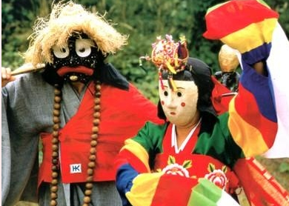
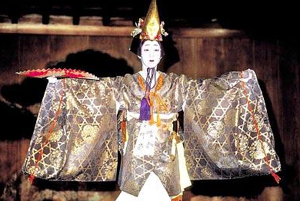
International Fiscal Association (IFA)
China, Japan and Korea Tax Conference
Wednesday and Thursday, May 19 and 20, 2010
KCCI Building, Seoul, Korea.
IFA KOREA 2010

Slide 2
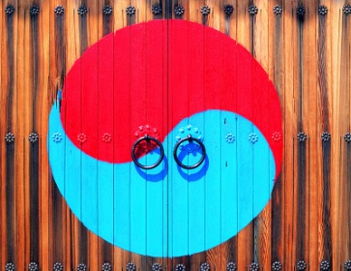
Dear Participants It is my great pleasure to welcome you to our 2010 China, Japan and Korea Tax Conference. The importance of North East Asian region for the development of global economy cannot be overestimated. Tax is one of the key issues for inter-jurisdictional trade and business in this region as is the case for other regions of the globe. Three major economies, China, Japan and Korea, although they are not posed at the same stage of economic development, have good reasons to cooperate for mutual understanding and learning about tax laws and administrations. Especially the recent amendments or negotiations of the tax treaties between the three countries with US are attracting huge interests from the businesses and practitioners. For this reason, IFA Korea, in cooperation with other branches, holds East Asia country regional seminar focused on the challenges under the recent tax reforms and the recent tax treaty amendments with the US. This coming seminar is the third one with this objective. The first was in Tokyo in March 2006 and the second was in Seoul in June 2008. Tax officials/professors/professionals from the three countries and the US are invited and will introduce recent development of tax law changes in their respective country and address implications of their recent treaty amendments with the US. Thank you for taking part in the 2010 China, Japan and Korea Tax Conference and I hope you will find this a rewarding and memorable experience. Yours faithfully Chul-Song Lee President of IFA Korea
China, Japan and Korea Tax Conference
Seoul, Korea, 19-20 May 2010
The Tax Challenges faced by East Asian Countries

Slide 3
China, Japan and Korea Tax Conference
Seoul, Korea, 19-20 May 2010
AGENDA
Prior Day Tuesday, 18 May 2010
Time | Subject
14:00pm – 17:00pm | Preparatory Meeting(for Speakers & Panelists Only)
1st Day Wednesday, 19 May 2010
Time | Subject
08:00am – 09:00am | Registration (Welcome to Seoul : video clips)
09:00am – 09:30am | Moderator: Prof. Moo-Seok Ok Opening Speech by President of IFA Korea Prof. Chul-Song Lee Welcoming speech by the Commissioner of the NTS
09:30am – 10:00am | IFA and OECD Developments Dr. H.A. Kogels (Secretary General, IFA)
10:00am – 10:30am | Coffee Break
10:30am – 12:30pm | Session I : Recent Tax Developments in China/Japan/Korea Moderator: Mr. David Jin-Young Lee (Korea) Speakers • Prof. Yoshihiro Masui (Japan) • Prof. Ji-Hyun Yoon (Korea) • Prof. Jian Wen Liu (China)
12:30pm – 14:00pm | Lunch
International Fiscal Association

Slide 4
China, Japan and Korea Tax Conference
Seoul, Korea, 19-20 May 2010
1st Day Wednesday, 19 May 2010
Time | Subject
14:00pm – 18:00pm | Session II : Tax Treaties between Three East Asian Countries and U.S. Moderator : Director General of MOSF (to be confirmed) Speakers • Mr. Feng Lizeng (China) • Mr. Kwanghyo Ko (Korea) • Prof. Tasuku Honjo (Japan) • Ms. Barbara Angus (US) Ms. Giovanna Sparagna (US) Mr. Michael Feder (US) Mr. Kyung-Geun Lee (Korea) Panelists : to be confirmed
15:30pm – 16:00pm | Coffee Break
18:00pm – 21:00pm | Culture Dinner (Invitation Only by President of IFA Korea)
2nd Day Thursday, 20 May 2010
Time | Subject
09:00am – 09:30am | International Tax Development Mr. Robert Couzin (Chairman of Scientific Committee, IFA)
09:30am – 10:00am | Coffee Break
10:00am – 12:00pm | Session III : Collective Investment Vehicle and Withholding Tax Moderator : Mr. Toshio Miyatake (Japan) Speakers • Ms. Moon-Kyun Cho (Korea) • Ms. Yuko Miyazaki(Japan） • Mr. Yuji Miyaki, (Japan) Panelists : to be confirmed
International Fiscal Association

Slide 5
China, Japan and Korea Tax Conference
Seoul, Korea, 19-20 May 2010
2nd Day Thursday, 20 May 2010
Time | Subject
12:00pm – 13:30pm | Lunch Luncheon Speaker: Prof. Hiroshi Kaneko, Ex-chairman of IFA Japanese Branch.
13:30pm – 17:00pm | Session IV: Transfer pricing documentation and advance pricing agreement Moderator : Mr. Yunjun Park (Korea) Speakers • Ms. Sun Yimin (China) • Prof. Kazufumi Iimori (Japan) • Mr. Henry An (Korea) Panelists : to be confirmed
15:00pm – 15:30pm | Coffee Break
17:00pm – 17:15pm | Closing speech : Ex-President of IFA Korea (Mr. Woo-Taik Kim)
Exhibitor Sponsors (to be amended)
IBFD Taxmann
Sponsors List (to be amended)
Korea Chamber of Commerce and Industry (KCCI) American Chamber of Commerce Korea (AMCHAM) European Union Chamber of Commerce Korea (EUCCK) Samsung, LG, POSCO PricewaterhouseCoopers, ERNST&YOUNG, Deloitte, KPMG Kim & Chang, Yulchon, Bae Kim & Lee, Shin & Kim, Lee & Ko
International Fiscal Association

Slide 6
China, Japan and Korea Tax Conference
Seoul, Korea, 19-20 May 2010
REGISTRATION FORM
We highly recommend completing the ONLINE REGISTRATION form through the Conference website www.ifakorea.org. If you do not register online, please complete one form per participant, and return to: Secretary General of IFA Korea: David Jin-Young Lee Samil PricewaterhouseCoopers, LS Yongsan Tower, 15th Floor 191, Hangangro 2-ga, Youngsan-gu, Seoul, Korea, 140-702 Tel(+82-2-709 0557) Fax+822 709 7977 E-mail:jylee@samil.com
(Please type or print in block letters and check appropriate boxes)
Name of Participant: Prof. Dr. Mr. Ms.
Family name: |  |  |  |  |  |  | First name |  |  |  |  |  | Middle initial
Company/Organisation:
Position:
Address: Office Home
 |  |  |  |  |  | Postal code |  |  |  |  |  | Country
Phone: |  |  |  |  |  | Fax: |  |  |  |  | E-mail:
Membership:
IFA Member Membership number:
Non-Member To apply for membership, please go to www.ifa.nl or www.ifakorea.org
Contact details during the IFA Tax Conference: I can be contacted by E-mail and / or Mobile phone:
E-mail address: _____________________________Mobile phone number: ___________________
Name of Accompanying Persons, if any:
An accompanying person is a participant’s spouse, partner, child or other personal relation who does not have a business or scientific interest in the Conference. Cultural Event Participation
Mr. Ms. Family name _________________ First name ___________________
Mr. Ms. Family name _________________ First name ___________________
Registration Fees:
Category | By 18 May 2010
Participant | US$300, Euro225 or KRW300,000
Accompanying Person | US$200, Euro150 or KRW200,000
I agree: I do not agree:
That my personal details be published in the List of Participants for the Tax Conference.
During the Congress the List of Participants will be made available to participants. Sponsors and third parties organising events may be supplied with List of Participants before the Conference.
International Fiscal Association

Slide 7
Page2 of Registration Form Please repeat name of participant: ___________________________________
PAYMENT (*Credit card issued outside Korea is accepted)
Credit card: |  |  |  | VISA * |  |  | Mastercard* |  | JCB* BC Card
Card number | / / / / / / / / / / / / / / / / / /
Name of cardholder: |  |  |  |  |  | Expiration date: (MM) |  |  |  | /YYYY
Security code*: ___________
VI/MC: final 3 digits on the reverse side of the card
Authorised signature:
Bank transfer
Name of Account: International Fiscal Association (Kukje Chose Hyuphoe)
Account Number: 325-20-197225 at Standard Chartered First Bank (SWIFT: SCBLKRSE)
Kukje Center Building, 191 Hangangro 2-Ga, Yongsan-Gu, Seoul, Korea
Deadline for bank transfers is 18 May 2010.
Please note that bank transmission fees have to be paid by the transmitter.
We would appreciate your sending us a copy of the bank receipt of your remittance to avoid possible confusion.
Date: ______________________________________ Signature: ___________________________________________
CANCELLATION:
In the event of cancellation, written notification should be sent to the IFA Seoul Registration Office.
The following cancellation fees will be deducted before any refund is made.
On and after 19 May 2010 100% of registration fee, thus no refund
ACCOMMODATION ARRANGEMENT:
The costs associated with the accommodation during your stay will not be borne by IFA Korea. Provided below are information of hotels for your booking.
Name | Address | Telephone number | Website | Rate per night | Distance from the venue
Millennium Hilton | 395, Namdaemun-5ga, Chung-gu, Seoul | +82 2 753 7788 | www.hilton.co.kr | \185,000 | 10 minute walk
Ramada Hotel & Suites Seoul Central | #151 Soonhwa-dong, Joong-gu, Seoul 100-130, Korea | +82 2 2119 8015 | www.ramadahns. com | \145,000 | 5 minute walk
Westin Chosun | 87, Sogong-dong, Jung-gu, Seoul, Korea 100-070 | +82 2 771 0500 | www.echosunhotel.com | \225,000 | 15~20 minute walk
Lotte | 1, Sogong-Dong, Jung-Gu, Seoul, Korea | +82 2 771 1000 | www.lottehotelseoul.com | \190,000 | 15~20 minute walk
Koreana | 61-1, 1 ka, Taipyung-ro, Chung-gu, Seoul | +82 2 2171 7845 | www.koreanahotel.com | \150,000 | 20 minute walk
Please keep a copy of this form for your own files.
I agree to the above mentioned conditions as well as the conditions stated in the Invitation Programme. I have read and accept the cancellation terms, disclaimer and insurance recommendations.
Signed by ______________________________________ Date ______________________________________
International Fiscal Association

Slide 8
International Fiscal Association

